Slide 1
Chapter 3: PIC18 Development Tools
The PIC18 Microcontroller
Han-Way Huang
Minnesota State University, Mankato
June 2004

Slide 2
PIC18 Development Tools
Hardware tools
software tools
Software Development Tools
Text editor or programmer’s editor
- Cross assembler
- Cross compiler
Terminal program
Simulator
Source-level debugger
Integrated Environment

Slide 3
Hardware Development Tools
In-circuit emulator
Device programmer
In-circuit debugger
Demo boards
Nature of Debugging Activities
Software and hardware must be developed in parallel.
Software must be debugged before the final hardware is completed.
There are two debugging approaches: software only approach and hardware assisted approach.
In the software approach, one uses a simulator or a demo board with a resident monitor program to debug the application software.
In the hardware approach, one uses either an in-circuit emulator or logic analyzer to perform software debugging activities. ICE and logic analyzer are expensive.

Slide 4
A Sample of Debugging Activities
Set breakpoints at suspicious instructions
Execute instruction until a certain breakpoint and check the result
Single step instructions in a certain region of the program.
Display register and memory contents.
Modify the register and memory contents and rerun the program

Slide 5
Software Development Tools from Microchip
- MPLAB: consists of a context-sensitive text editor, cross assembler, linker, simulator, and source level debugger.
- PIC18 cross C compiler
MPLAB also allows other companies’ C compilers to work with MPLAB.
C compilers from HI-TECH, CCS, Byte Craft, and IAR can work under the MPLAB environment.

Slide 6
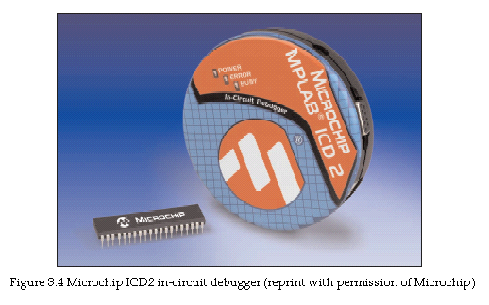
Hardware Tools Required for Development PIC18
The combination of the ICD2 from Microchip and a well-designed demo board are required for learning the PIC18 microcontroller.

Slide 7
Demo Boards
Available from several vendors
Shuan-Shizu developed three PIC18 demo boards for the purpose of learning the PIC18 Microcontrollers.
The SSE452 is designed for experimenting with PIC18F452 and other 40-pin and 28-pin PIC18 Microcontrollers.
The SSE8680 is designed for experimenting with PIC18F8680
The SSE8720 is designed for experimenting with PIC18F8720
Both the SSE8680 and SSE8720 have the same design
All three demo boards allow the user to exercise all peripheral functions available in the PIC18 MCU.

Slide 8
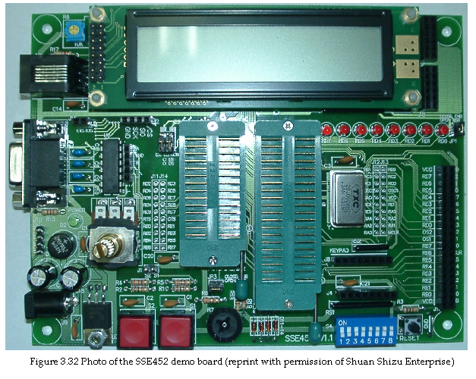

Slide 9
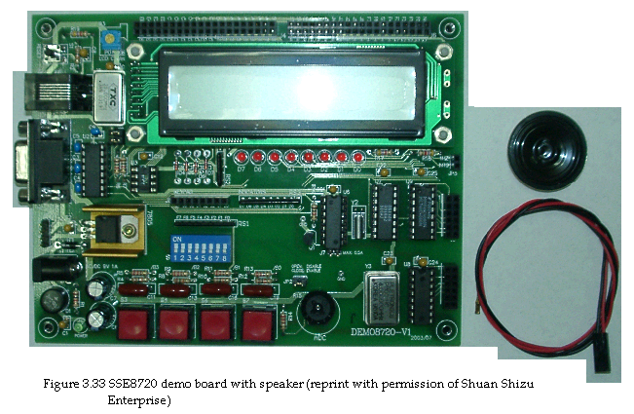

Slide 10
